Slide 1

Circular Linked Lists - [CLL]

Slide 2
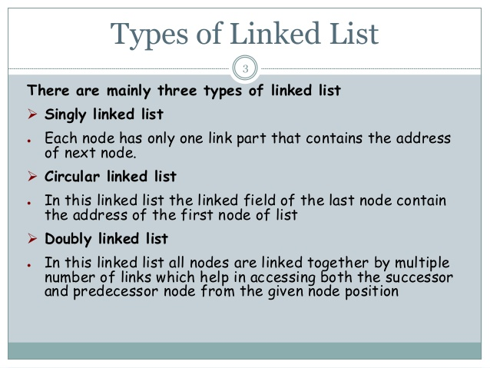

Slide 3
Circular Linked Lists
A Circular Linked List is a special type of Linked List.
It supports traversing from the end of the list to the beginning by making the last node point back to the head of the list.
A Rear pointer is often used instead of a Head pointer
10
20
40
55
70
Rear

Slide 4
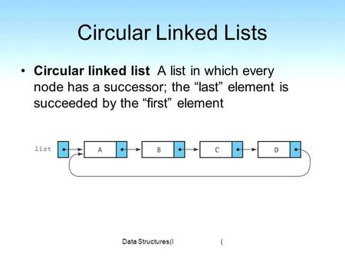
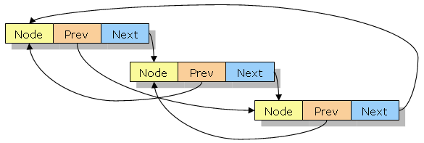

Slide 5
Motivation
Circular linked lists are usually sorted.
Circular linked lists are useful for playing video and sound files in “looping” mode.
circularly linked list, all nodes are linked in a continuous circle, without using null.
For lists with a front and a back (such as a queue), one stores a reference to the last node in the list.
The next node after the last node is the first node.

Slide 6
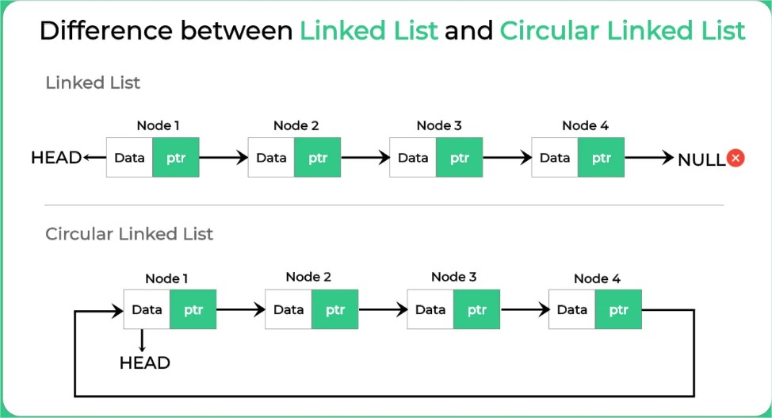

Slide 7
